Slide 1



Slide 2
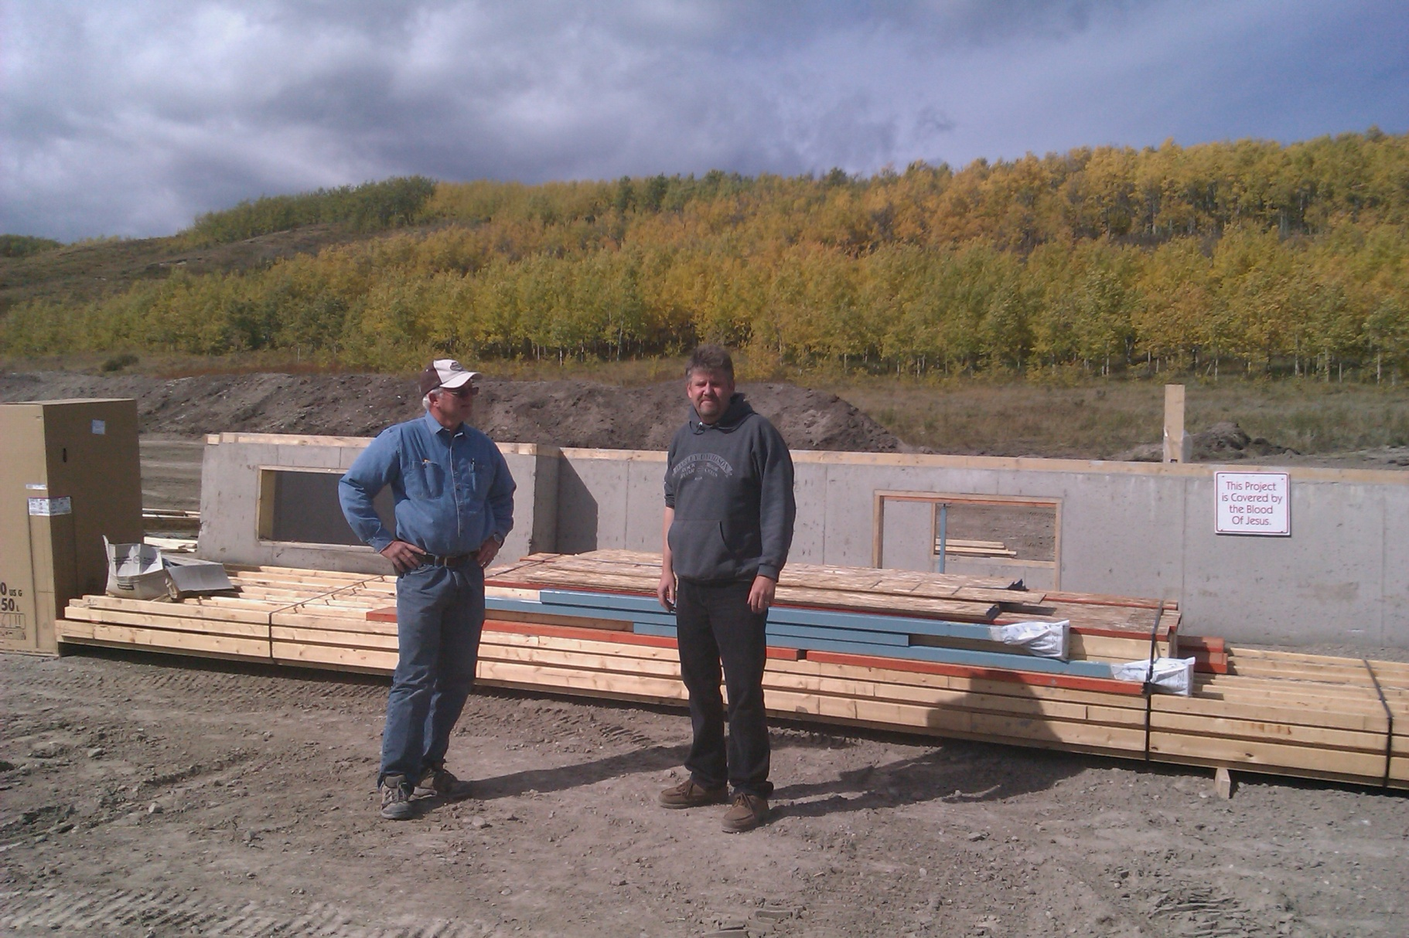
Are we nuts?
Fri.
1:45pm

Slide 3
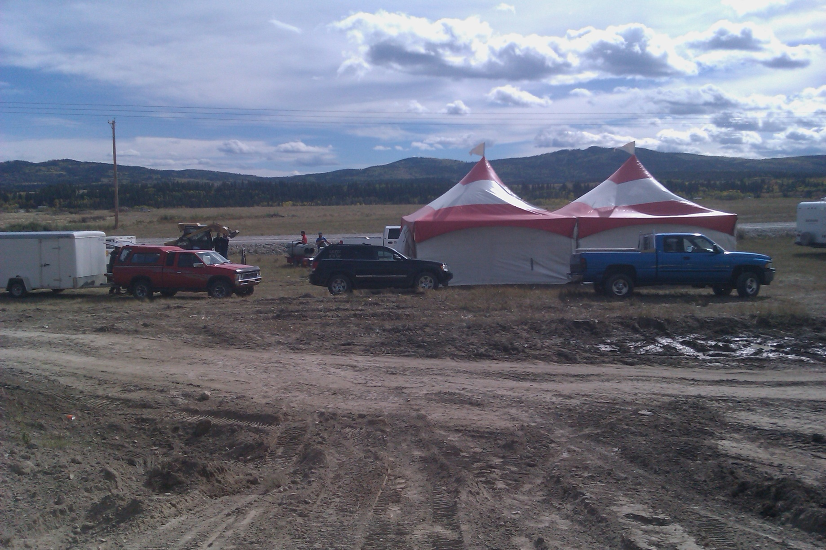
The chow tents are ready? Check.
Fri.
2 pm

Slide 4
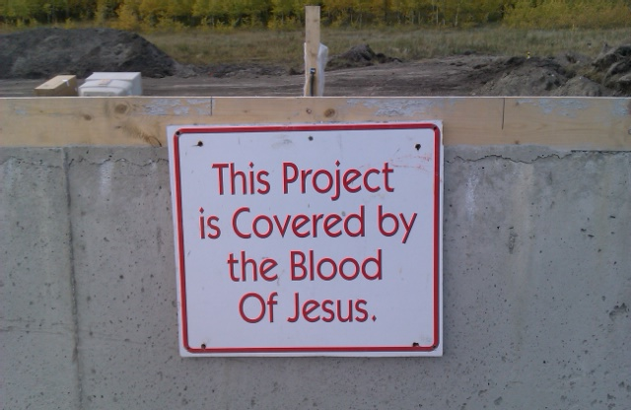
Our primary insurance policy.
Fri.
2 pm

Slide 5
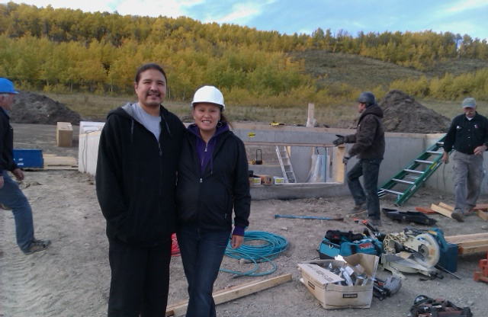
Linda & Brian before we launched.
Fri.
5:16 pm

Slide 6
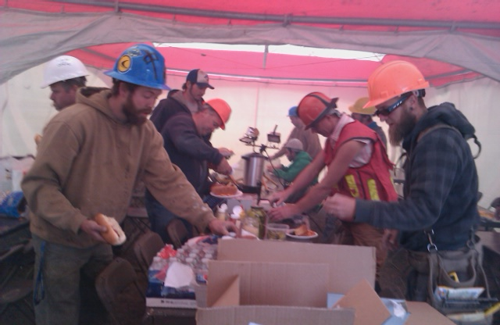
Fueling up to fire away!
Fri.
5:27 pm

Slide 7
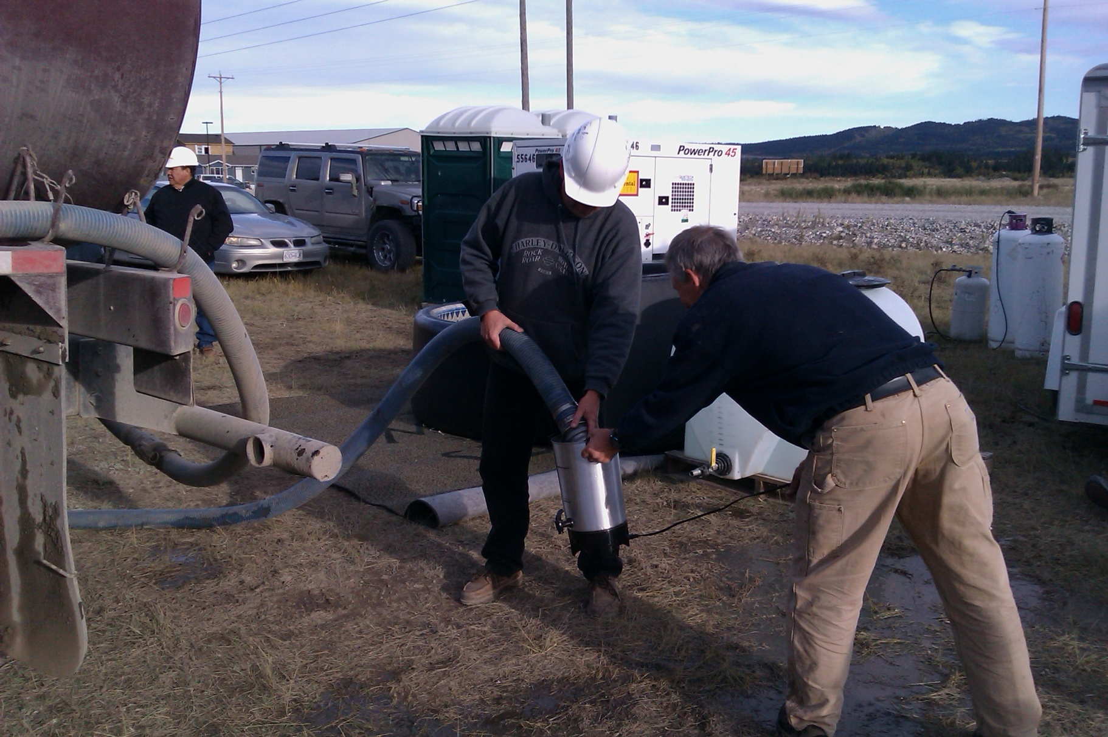
Loading the coffee pot for later.
Fri.
5:34 pm

Slide 8
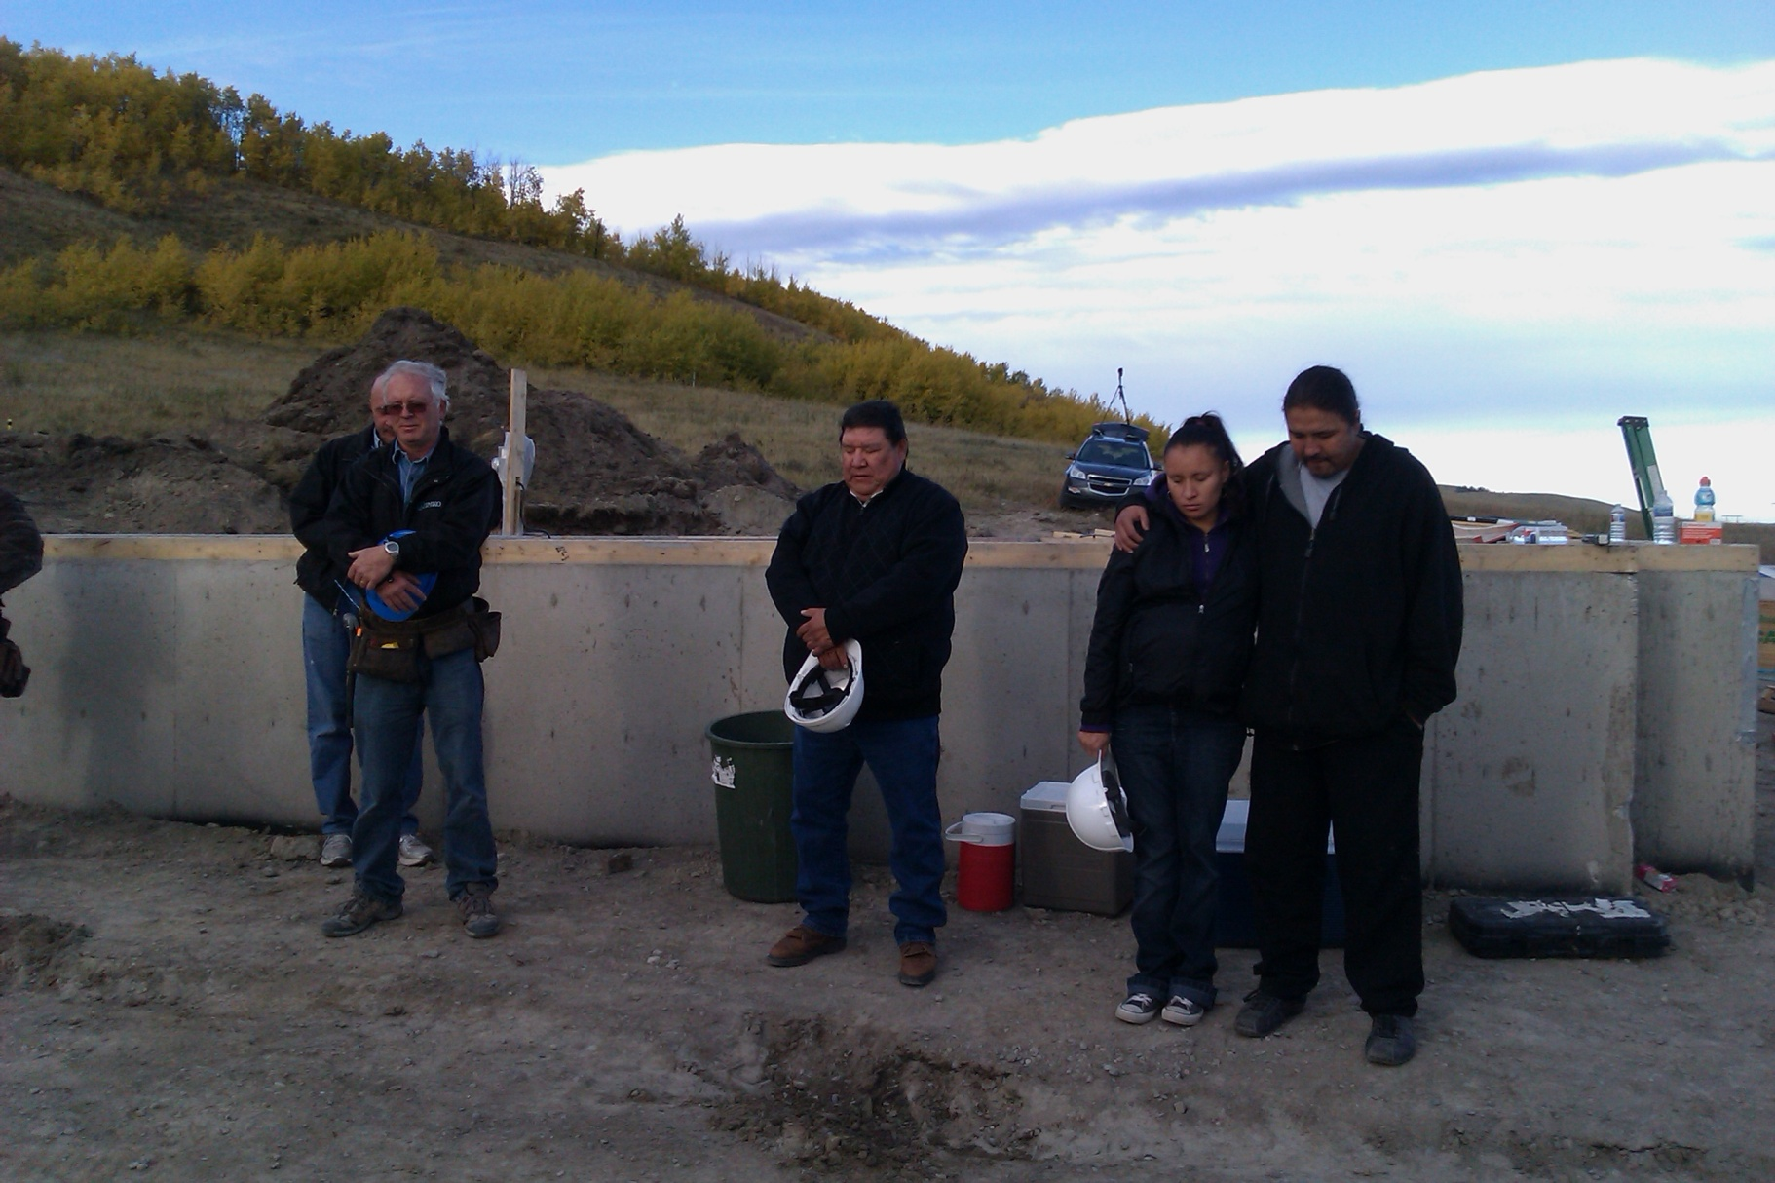
Prayer before we kick it off.
Fri.
5:59 pm

Slide 9
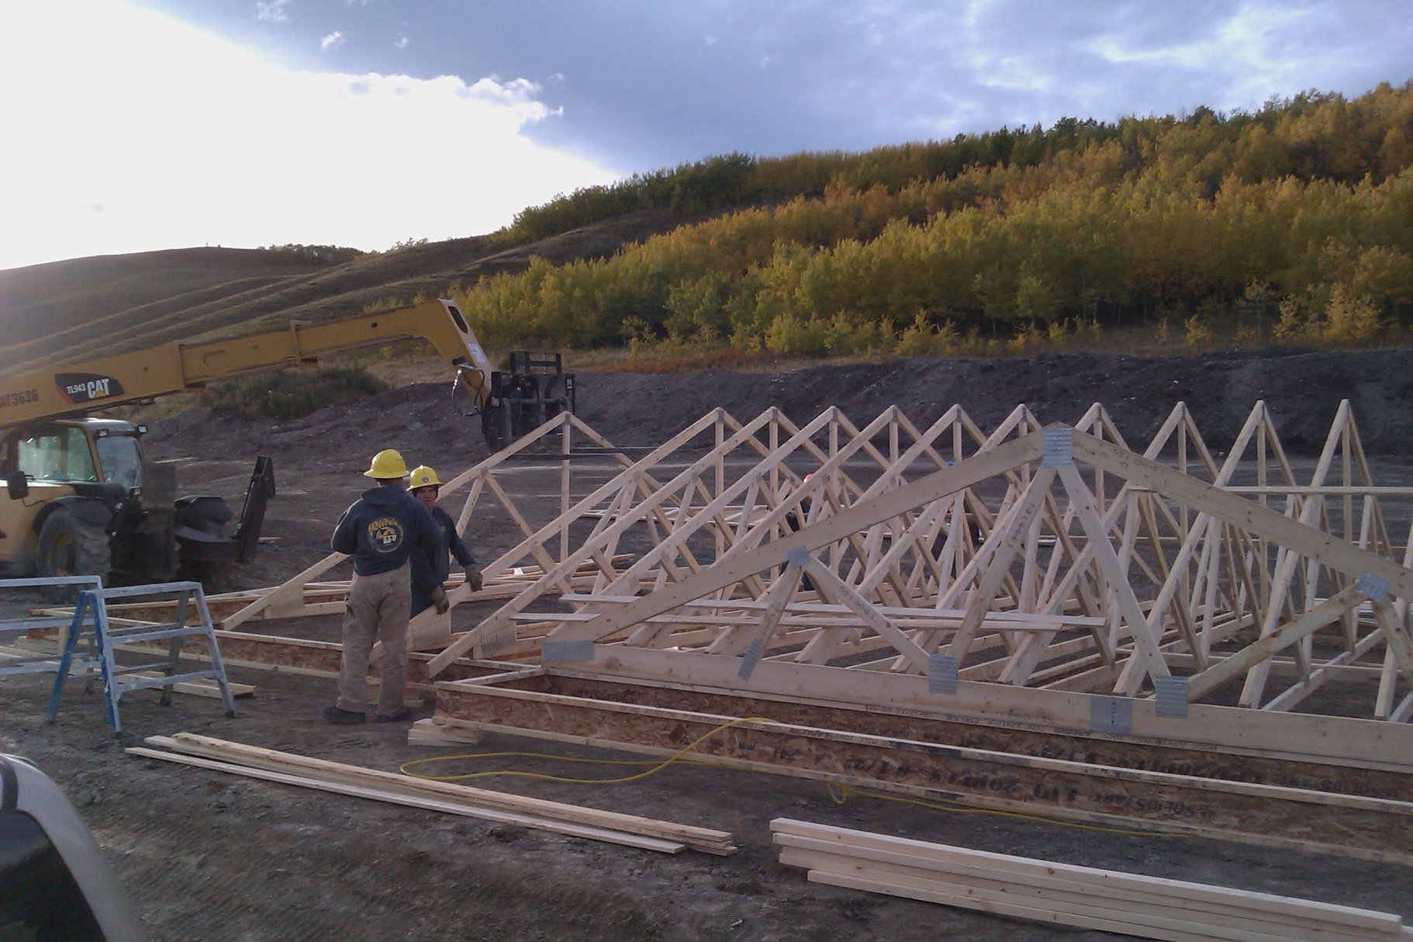
Apparently rafters stand themselves up.
Fri.
6.18 pm

Slide 10
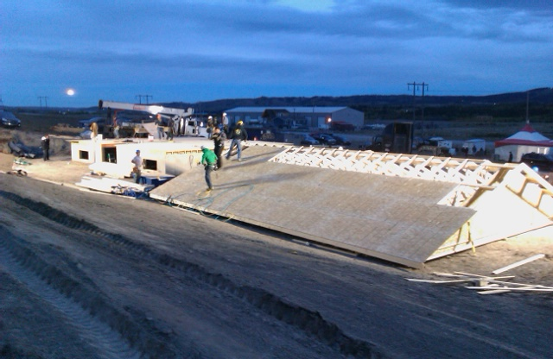
Sheathing requires some nails.
Fri.
7:43 pm

Slide 11
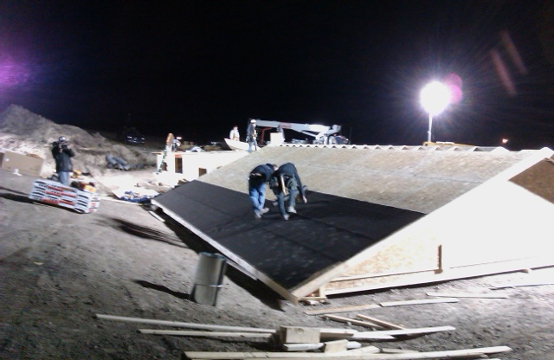
Shingles take more nails again
Fri.
8:21 pm

Slide 12
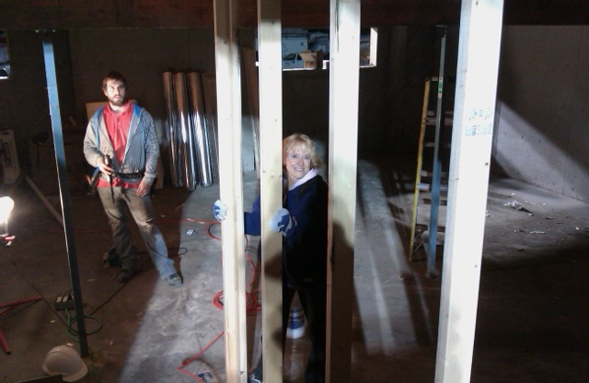
Basement framing well under way with the experts.
Fri.
9:01 pm

Slide 13
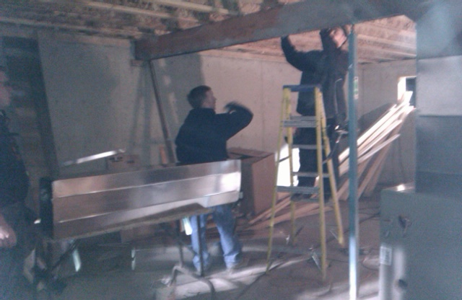
The furnace is coming into play.
Fri.
9:21 pm

Slide 14
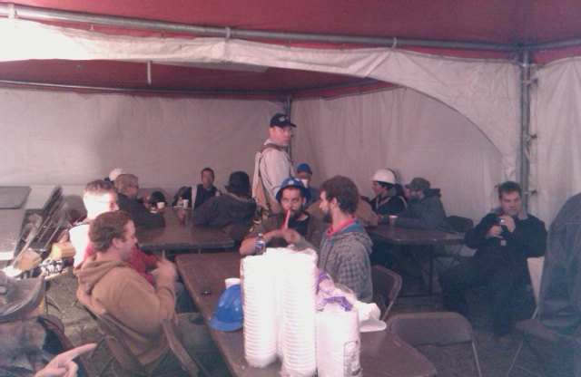
Coffee time. Everybody’s still fresh.
Fri.
9:39 pm

Slide 15
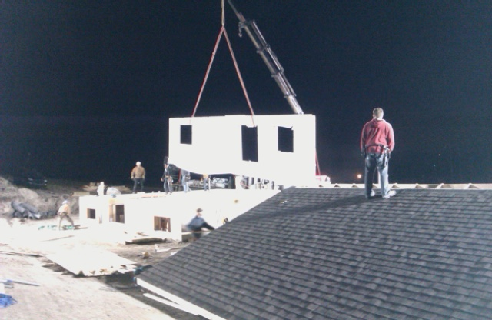
Walls swinging onto a now completed floor.
Fri.
9:56 pm

Slide 16
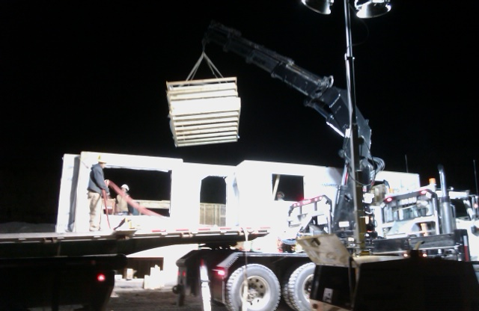
Inside walls got dropped… well, inside.
Fri.
10:41 pm

Slide 17
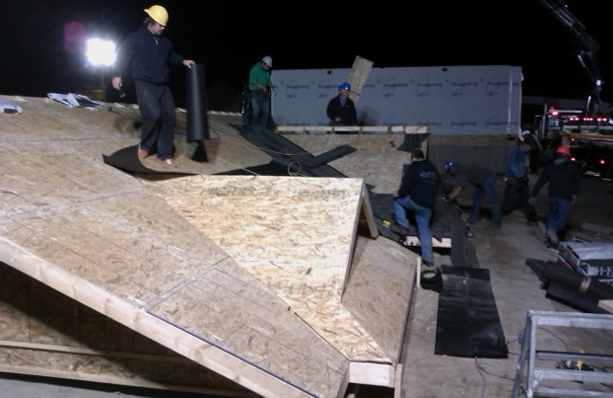
Roofing is now rolling on front side.
Fri.
10:43 pm

Slide 18
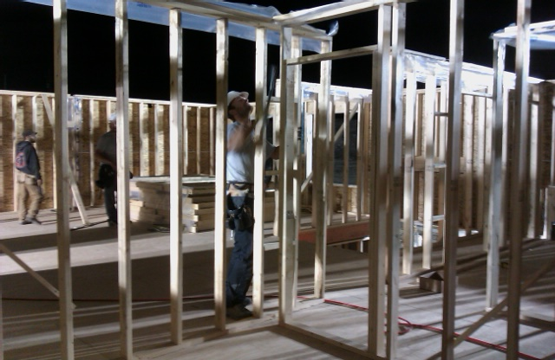
Walls are better when their plumb…
Fri.
10:47 pm

Slide 19
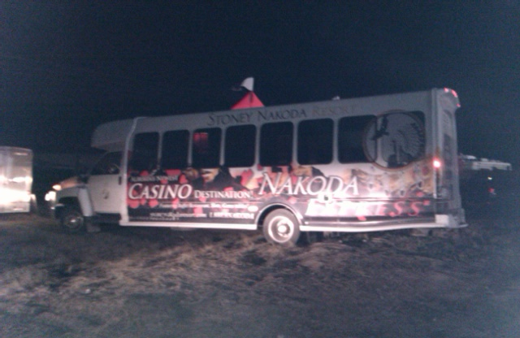
Bringing out more chow.
Fri.
11:38 pm

Slide 20
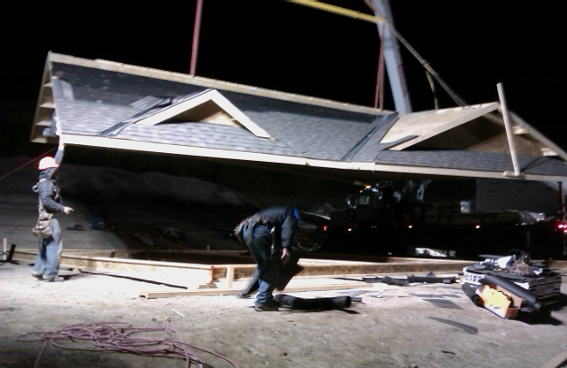
I swear that roof is hovering.
Fri.
11:44 pm

Slide 21
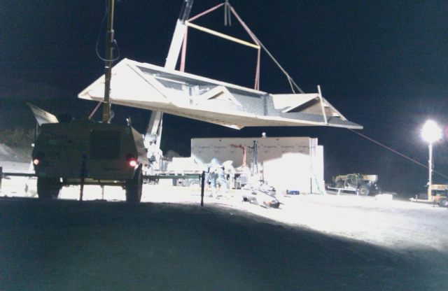
Still hovering.
Fri.
11:45 pm

Slide 22
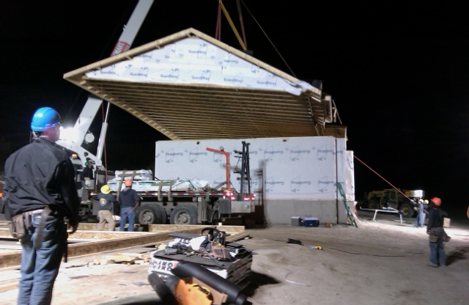
Still hovering.
Fri.
11:46 pm

Slide 23
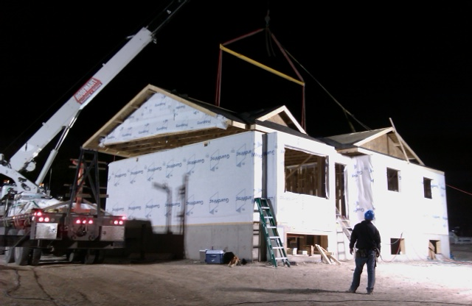
Almost there.
Fri.
11:48 pm

Slide 24
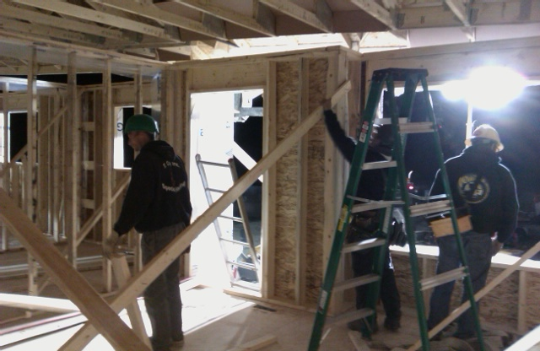
Re-bracing some walls.
Sat.
12:13 am

Slide 25
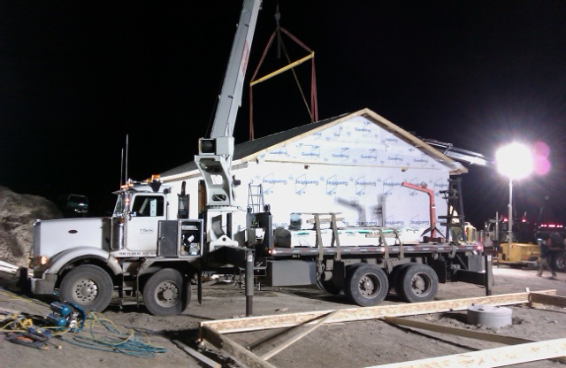
Finally.
Sat.
12:26 am

Slide 26
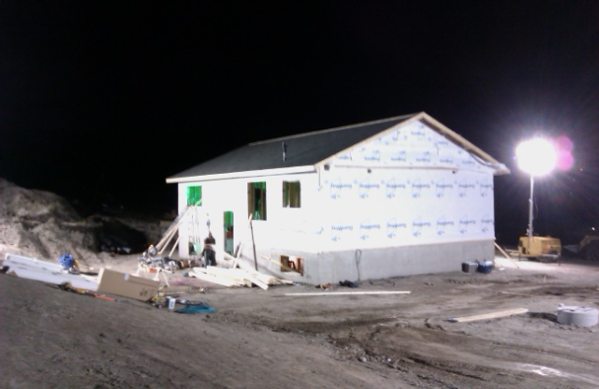
Now the action is inside.
Sat.
2:37 am

Slide 27
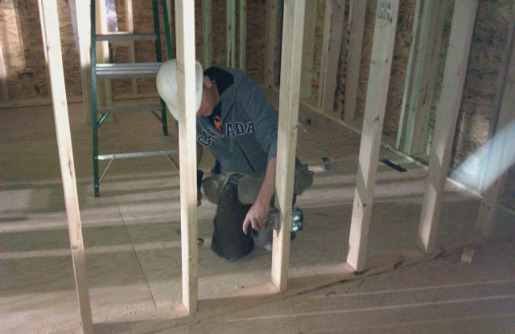
Electrical Rough-in.
Sat.
2:39 am

Slide 28
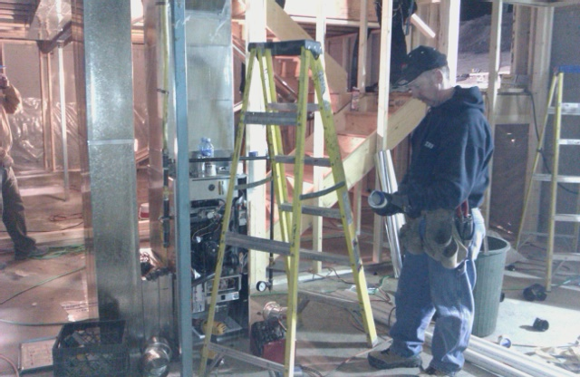
Furnace & ducting are almost complete.
Sat.
2:42 am

Slide 29
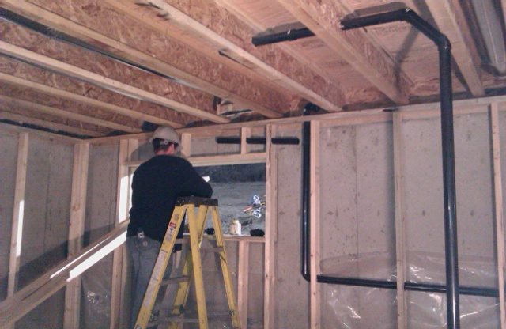
Plumbing rough-in under way.
Sat.
3:15 am

Slide 30
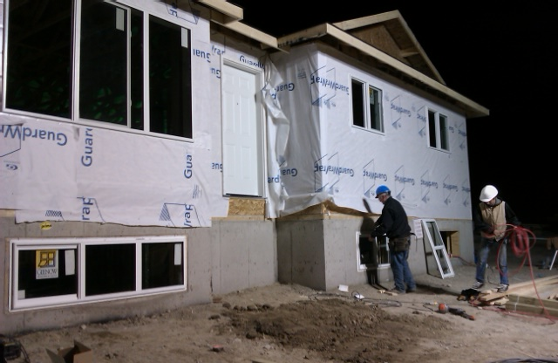
Tacking the windows in place.
Sat.
3:49 am

Slide 31
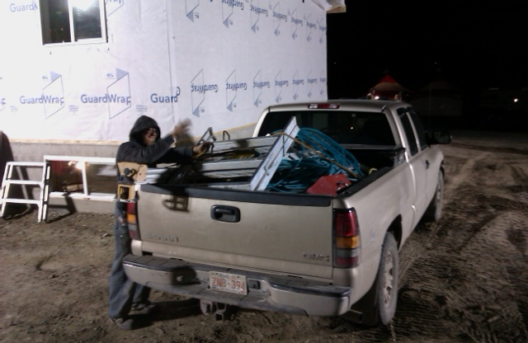
Framers have left the building. (and taken Elvis with them)
Sat.
4:28 am

Slide 32
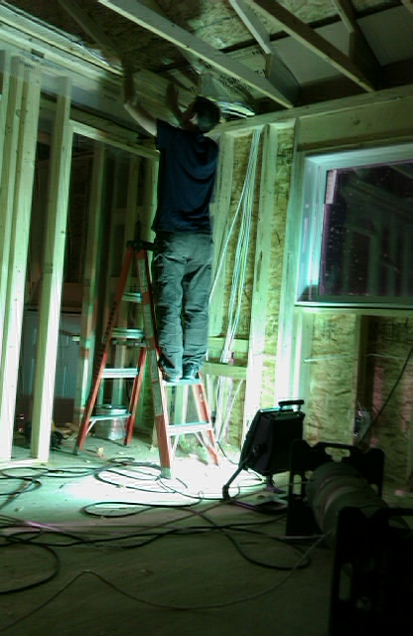
Wires everywhere!
Sat.
4:30 am

Slide 33
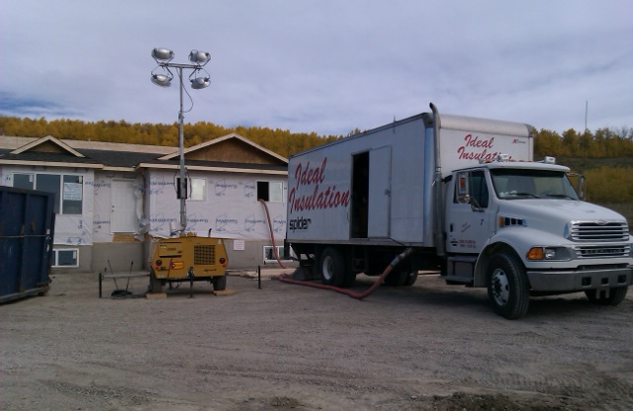
Ceiling insulation blowing in.
Sat.
10:42 am

Slide 34
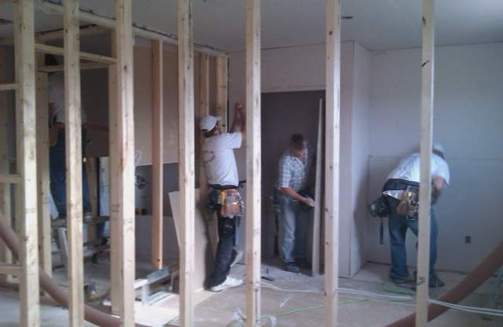
Drywallers seem to be in a rush. Wonder why.
Sat.
10:45 am

Slide 35
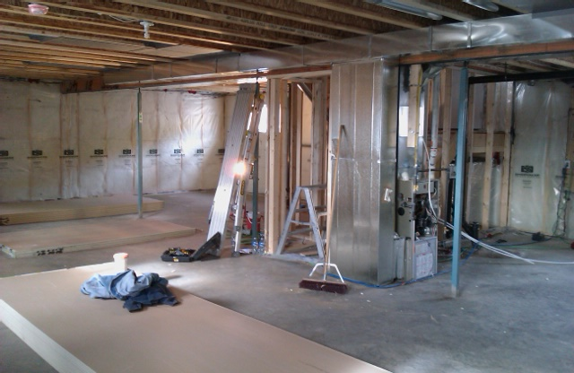
Basement insulated and sealed.
Sat.
10:47 am

Slide 36
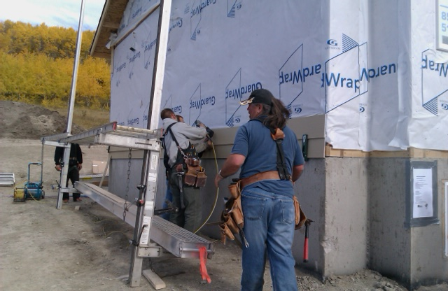
Siders are under way.
Sat.
10:55 am

Slide 37
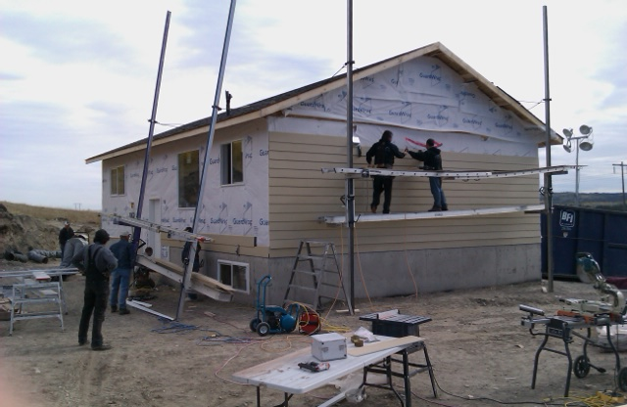
Still siding.
Sat.
12:02 pm

Slide 38
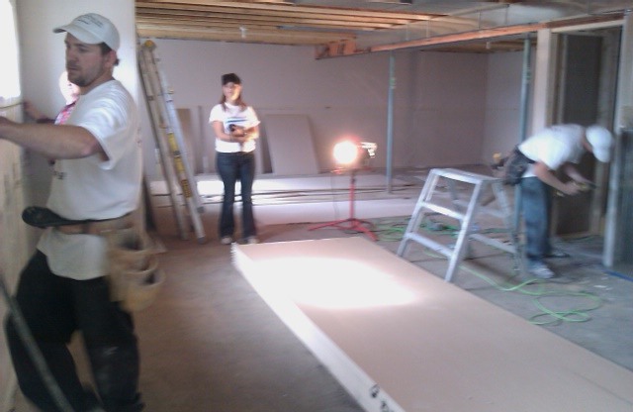
Drywallers hiding the insulation.
Sat.
12:05 pm

Slide 39
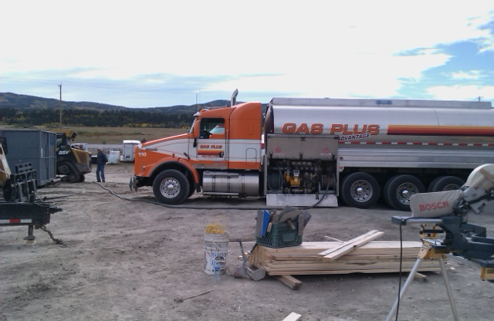
Time to re-load all diesel equipment.
Sat.
12:08 pm

Slide 40
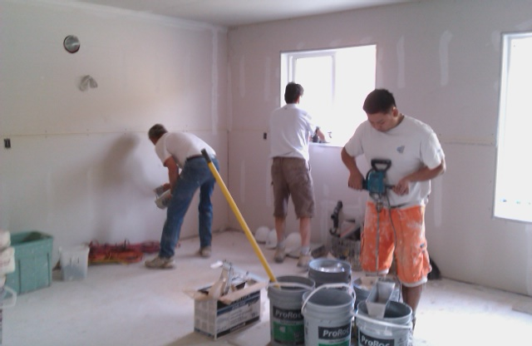
Drywallers have all the board up & lots of mud.
Sat.
12:38 pm

Slide 41
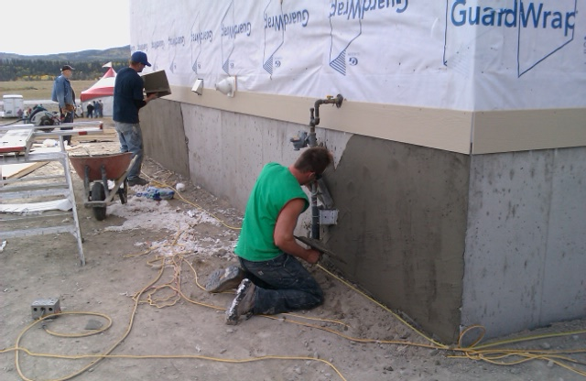
Louis is throwing on parging as fast as he can get it.
Sat.
12:45 pm

Slide 42
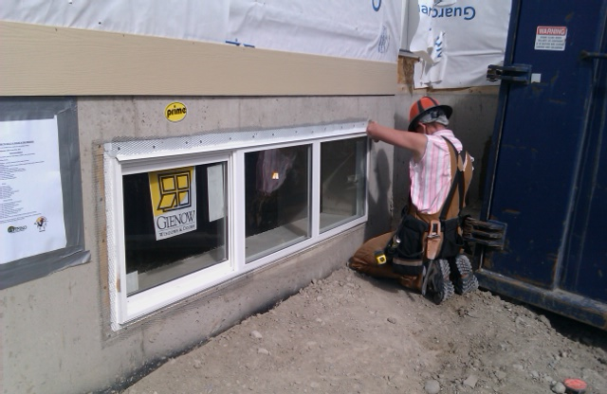
Al is trying to stay ahead of Louis.
Sat.
1:22 pm

Slide 43
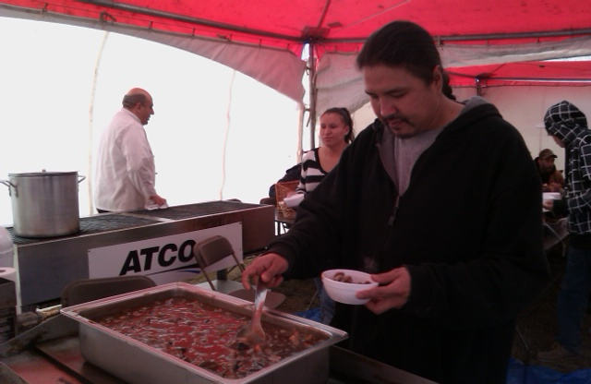
Chow time once again. Delicious.
Sat.
1:28 pm

Slide 44
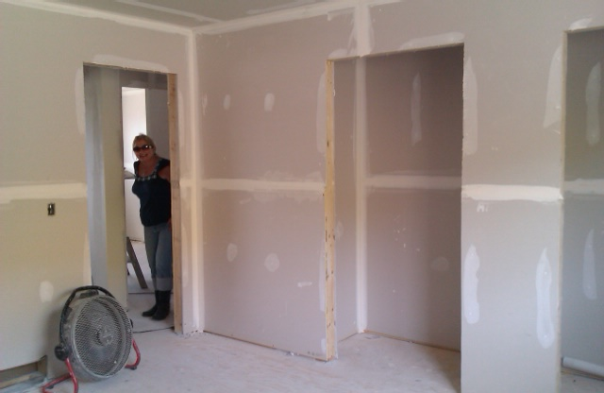
Drywall is now waiting for sanding.
Sat.
2:39 pm

Slide 45
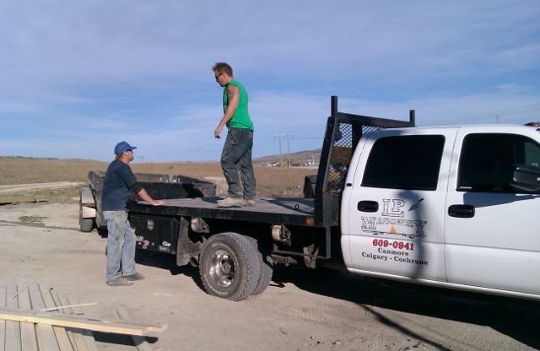
Louis is packing up. He’s outaaaah here.
Sat.
2:39 pm

Slide 46
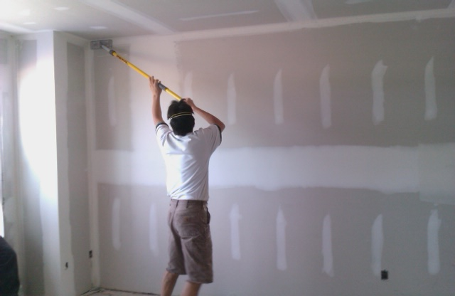
Sanding the 2nd coat of drywall mud.
Sat.
5:00 pm

Slide 47
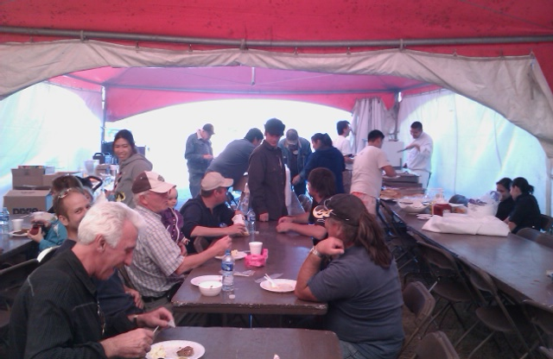
Supper at supper time… instead of midnight.
Sat.
6:33 pm

Slide 48
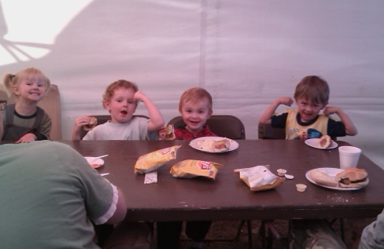
Next year’s crew…
Sat.
6:33 pm

Slide 49
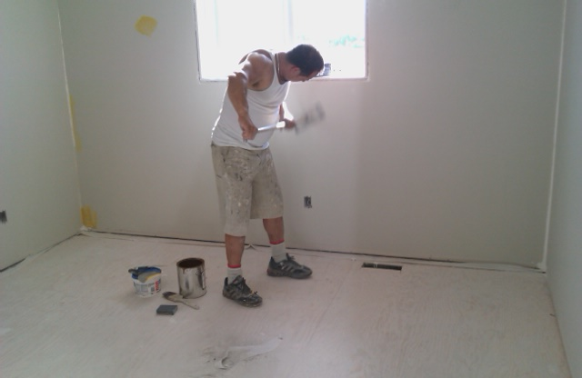
Gio’s hard at it sanding his touchups.
Sun.
10:36 am

Slide 50
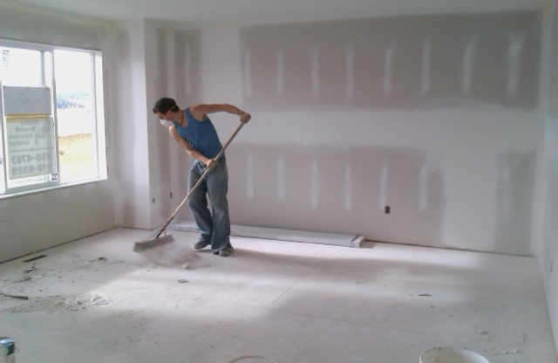
Prepping the floors for floor leveling patch.
Sun.
10:40 am

Slide 51
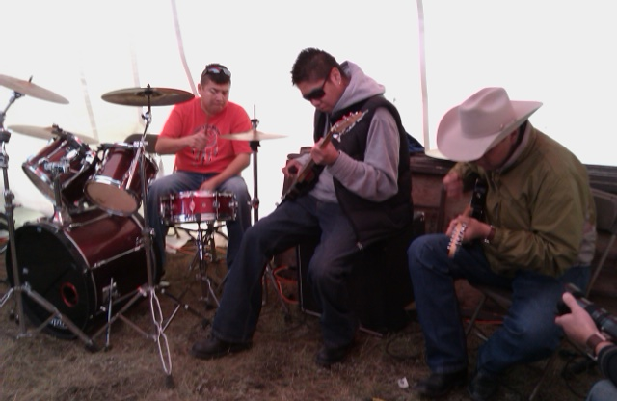
Church break native style.
Sun.
11:04 am

Slide 52

Gio’s guys chugging along.
Sun.
11:18 am

Slide 53

Even the painters break for food.
Sun.
1:15 pm

Slide 54

Gio’s worst employee goes on strike…
Sun.
1:52 pm

Slide 55

Siding guys moved back to roofing. Nice clouds.
Sun.
4:01 pm

Slide 56

Painters are outa heeeerrrrrre.
Sun.
4:03 pm

Slide 57

Roofers are racing.
Sun.
4:11 pm

Slide 58

Flooring guys are painting the floors?
Sun.
4:51 pm

Slide 59

Adios to the sun for the last time.
Sun.
7:17 pm

Slide 60

Cabinet guys are messing up the place again.
Mon.
7:30 am

Slide 61

Rhonda’s showing the boys how to do finishing.
Mon.
7:37 am

Slide 62


Jeff & Ron swear they already know how…
Mon.
7:37 am

Slide 63

The boss just shakes his head and sighs.
Mon.
7:37 am

Slide 64

Oh, that’s what was in those boxes.
Mon.
7:57 am

Slide 65

Time to take down the stadium lights.
Mon.
9:00 am

Slide 66

Oh, that looks nice.
Mon.
9:06 am

Slide 67

What’s a house without closets?
Mon.
9:07 am

Slide 68

Um, guys. Notice the big 1st step in front?
Mon.
9:11 am

Slide 69

Heating her up for laminate.
Mon.
9:51 am

Slide 70

Terry Harkness helping out with finishing.
Mon.
9:52 am

Slide 71

Siding and front porch all at once.
Mon.
11:04 am

Slide 72

The deck guys… um… needed help.
Mon.
11:07 am

Slide 73

Terry putting up blinds.
Mon.
11:11 am

Slide 74

Flooring guys came back for trim.
Mon.
11:15 am

Slide 75

Apparently Tim thought we had spare time…
Mon.
11:21 am

Slide 76

If you weren’t tired before, now you’re toast!
Mon.
1:20 pm

Slide 77

Looks easy enough…
Mon.
1:58 pm

Slide 78

See, he knew we could get it done.
Mon.
3:23 pm

Slide 79

Time for touchups.
Mon.
3:30 pm

Slide 80

… and cleanup.
Mon.
5:13 pm

Slide 81

… and more cleanup.
Mon.
5:14 pm

Slide 82

… and more cleanup.
Mon.
5:13 pm

Slide 83

… and more cleanup.
Mon.
5:18 pm

Slide 84

… and unwrapping the toys.
Mon.
5:19 pm

Slide 85

While the bosses wait to see if we keep our deadlines.
Mon.
5:24 pm

Slide 86

6:00pm Monday, Sep. 27. 72 hours from launch!
Mon.
6:00 pm

Slide 87

The bus pulled away. Now cut that ribbon!!
Mon.
6:07 pm

Slide 88

Oh ya… and ignore all those cameras…
Mon.
6:13 pm

